Slide 1
Impact of COVID-10 on NYC Taxi Industries
Problem Statement
NYC Taxi Cab Association requested Data Scientist to assess the effect of COVID on the Taxicab industry on the 2nd H 2020 and 1st H 2021.

Slide 2
Assumptions
Task will be carried out on Yellow Taxi Cap as one of the companies impacted by COVID-19
COVID-19 restrictions measure will continue for the H2-2021

Slide 3
Scope of Work
Collect the data
Data profiling and cleaning
Merge the data into one data Model (OLAP)
Conduct BI Analytics
Develop a machine learning code to predict the future

Slide 4
Data Preparation
Taking Yellow Taxi Cab sales data from Jan 2020 – Jun2020
https://www1.nyc.gov/site/tlc/about/tlc-trip-record-data.page
Taking COVD-19 data from
https://github.com/nytimes/covid-19-data/blob/master/us-states.csv
Aggregate Data from Both sources at date level and join on date key

Slide 5
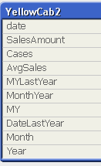
Data Model
Aggregate Data from Both sources at date level and join on date key
date | SalesAmount | Cases
20200312 | 3159825.18 | 326
20200331 | 154658.66 | 76211
20200308 | 3063791.3 | 212
20200307 | 3621673.63 | 178
20200309 | 3254180.47 | 284
20200313 | 2424903.52 | 421
20200311 | 3298933.32 | 217
20200310 | 4332005.73 | 346
20200329 | 92030.67 | 59783
20200317 | 806046.36 | 1375
20200315 | 1096629.25 | 732
20200314 | 1510703.83 | 610
20200319 | 501779.09 | 4161
20200306 | 4539602.47 | 44
Yellow Cap trip data from Jan – June 2020 contains data of out of the range such as year 2009, 2010
Data points (sales) during the COVID-19 is very small (3 months only) that is about 90 data points

Slide 6
Data Visualization
Row Labels | SalesAmount_ | No of Cases
Jan | $119,538,722 | 0
Feb | $117,114,233 | 0
Mar | $56,655,174 | 590466
Apr | $3,903,168 | 7939509
May | $6,854,105 | 14024460
Jun | $9,847,968 | 14766772
Grand Total | $313,913,370 | 37321207

Slide 7
What is the Relation

Slide 8
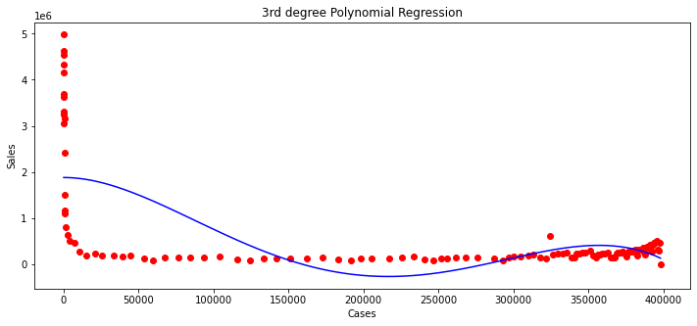
Polynomial Relation
R2 = 64
Polynomial Relation 3th degree equation is best fit.

Slide 10
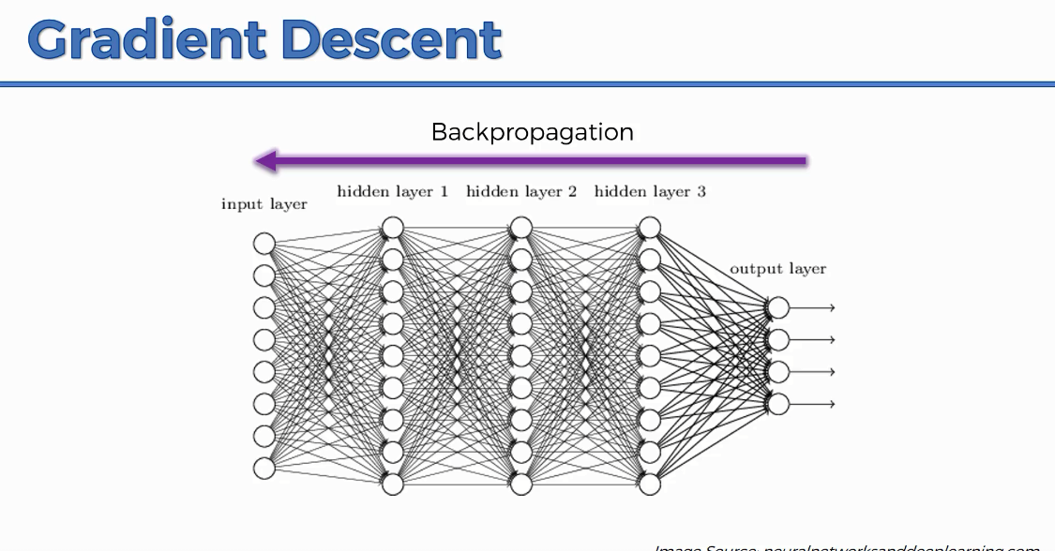
Predicting The future Sales Under COVID-19 restrictions
The Long Short-Term Memory network or LSTM network is a type of recurrent neural network used in deep learning because very large to learn from long sequence of observation and predict future sequence
If you want to add more value to RNN, recommend checking out:
https://www.superdatascience.com/blogs/the-ultimate-guide-to-artificial-neural-networks-ann

Slide 11
LSTM Approach
Take Data from 1st March at the time of Pandemic break out
Decide of number of days to look back and training your model timesteps= 30
Process the data train and test set
Create an array of Matrix of time series as features of RNN input
Create this Matrix for x_train and y_train
Create LTSM stacked layers model
Train the Model
Predict the future 365 days
Create data set from Jan 2020 – June 2021 and save it on file
Plot the out of the predicted sales

Slide 12
Model Summary
## Model Consist of 3 hidden layers and one output layer
model=Sequential()
# Add LSTM layer
model.add(LSTM(50,return_sequences=True,input_shape=(time_steps,1)))
model.add(LSTM(50,return_sequences=True))
model.add(LSTM(50))
model.add(Dense(1))
model.compile(loss='mean_squared_error',optimizer='rmsprop')
model.fit(X_train,y_train,validation_data=(X_test,ytest),epochs=100,batch_size=5,verbose=1)
Layer (type) Output Shape Param #
=================================================================
lstm_37 (LSTM) (None, 30, 50) 10400
_________________________________________________________________
lstm_38 (LSTM) (None, 30, 50) 20200
_________________________________________________________________
lstm_39 (LSTM) (None, 50) 20200
_________________________________________________________________
dense_13 (Dense) (None, 1) 51
=================================================================
Total params: 50,851
Trainable params: 50,851
Non-trainable params: 0

Slide 13
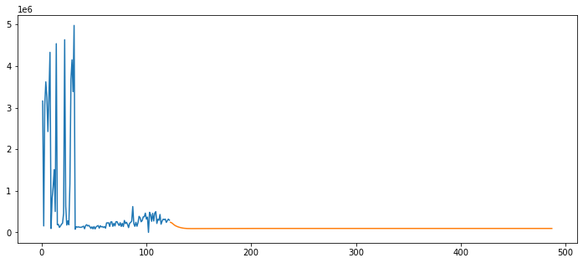
NYC Taxi Sales in the next 365
%Sale Reduction from 2020-2021 | % Sales
Jan | -87%
Feb | -92%
March | -75%
April | 318%
May | 103%
June | 27%
Year Month | SalesAmount_
2020
Jan | $141,553,616
Feb | $153,356,258
Mar | $73,392,651
Apr | $4,641,291
May | $8,395,926
Jun | $12,180,022
Jul | $16,710,885
Aug | $23,461,086
Sep | $23,817,217
Oct | $12,916,690
Nov | $14,844,591
Dec | $22,074,406
2021
Jan | $18,734,310
Feb | $12,608,695
Mar | $18,380,103
Apr | $19,403,955
May | $17,024,766
Jun | $15,463,180
Grand Total | $608,959,647

Slide 14
NYC Predicted COVID-19 Cases next 365
Year/Month | No of Cases
2020
Jan | 0
Feb | 0
Mar | 590,466
Apr | 7,939,509
May | 14,024,460
Jun | 14,766,772
Jul | 14,531,397
Aug | 16,659,969
Sep | 16,296,615
Oct | 15,233,045
Nov | 14,538,797
Dec | 15,400,734
2021
Jan | 17,703,015
Feb | 13,908,602
Mar | 15,376,260
Apr | 14,303,815
May | 16,200,596
Jun | 16,765,461
Grand Total | 224,239,511

Slide 15
Overall Taxi Industry Impact
In Case of Continues Restrictions Taken
Sales will be reduced in monthly basis by %75 up %97

Slide 16

Thank You
Code / Data Repository
https://github.com/ziadmohd/NYCYellowTaxi

